Slide 1
TA Management Portal
CSCE 606 Software Engineering

Slide 2
Professor
Client
Team Members
Philip Ritchey
Susan Ritchey
Scrum Master
Alexander Muyshondt
Product Owner
Opeyemi Alabi
Team Member
Kimleng Hor
Team Member
Boxuan Hu

Slide 3
Overview
TA Management system: Build an online TA application and management system.
Features include :
Professor can email TA’s
Professor can view his/her schedule
Admin can add or delete schedules
Admin can edit user information without password of user
Coordinator can login without having access to admin portal
Coordinator can re-assign TA’s
Student can view his/her status
User can login with sessions

Slide 4
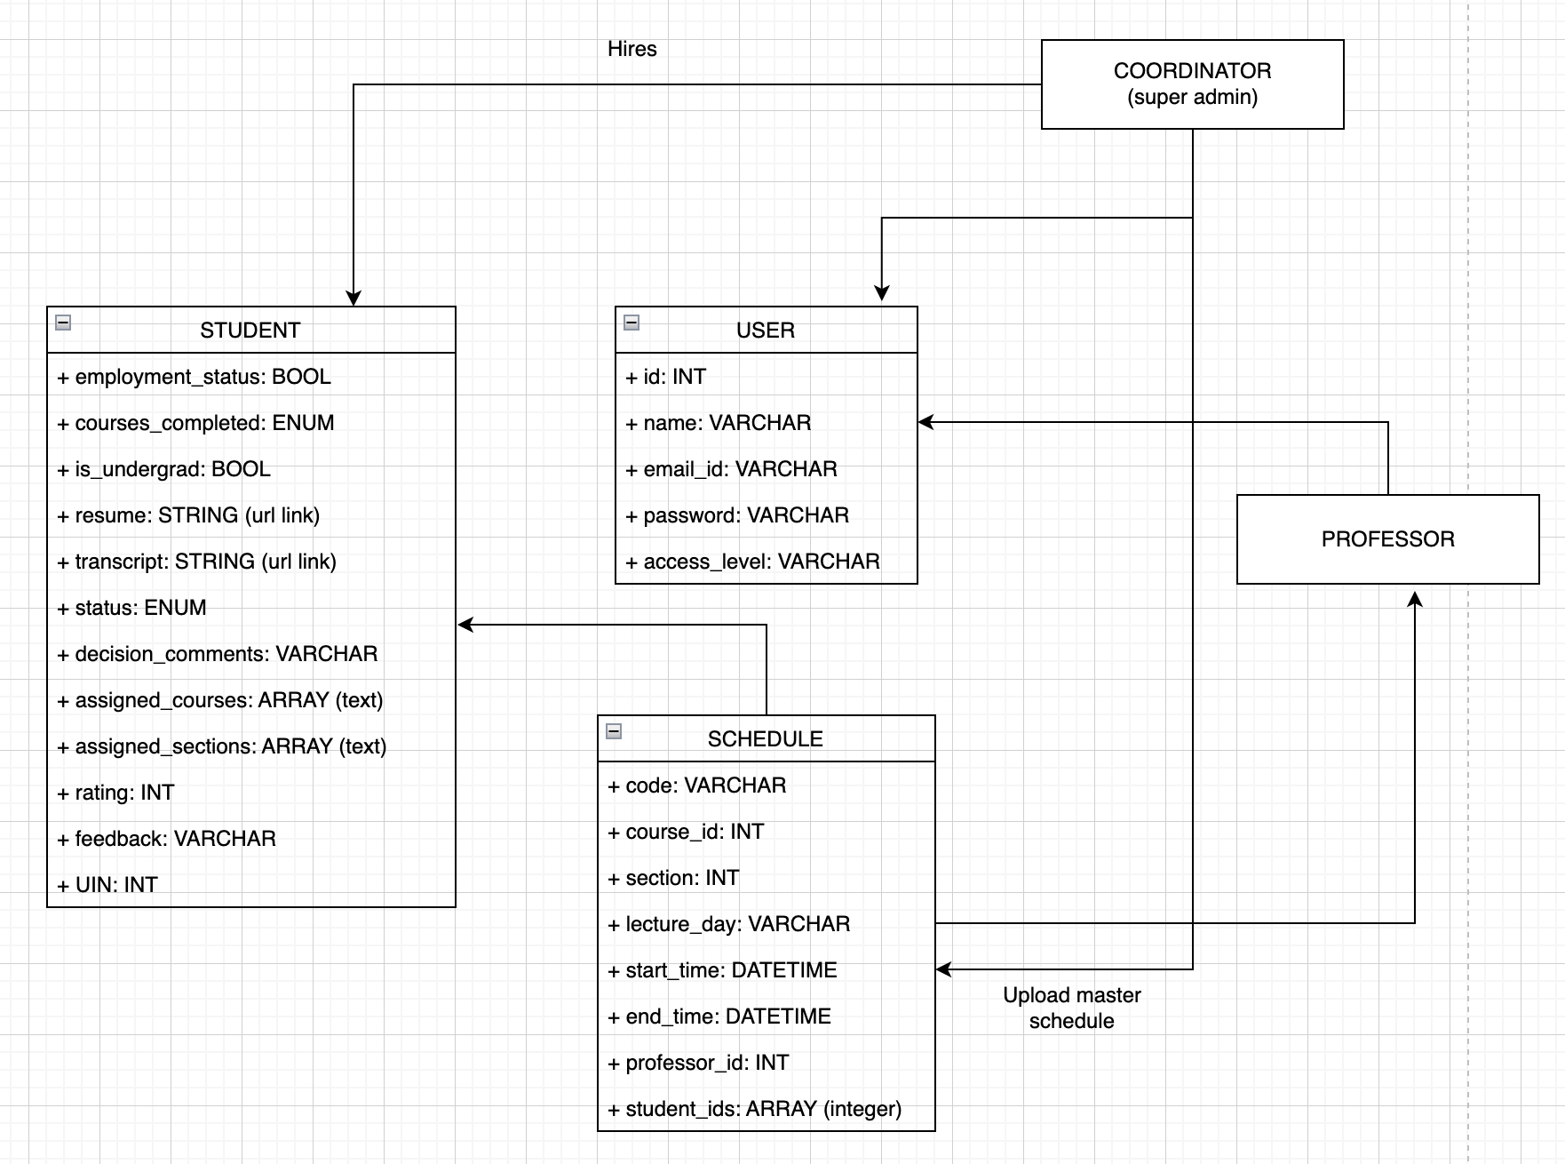
Class Diagram

Slide 5
Project Validation : Testing Approaches
BDD ( Cucumber Testing)
Student Application Validation: Various validation checks were added like numerical UIN, proper email id, no blank fields etc.
Login & Sign-Up Validation: Checks such as proper password and same password, no blank fields etc. are added.
Schedule upload & remove validation: Check whether the schedule is uploaded or not and check if the schedule is removed or not
TDD ( RSpec Testing)
Unit test cases for all data models such as students, schedules, users were added

Slide 6
Problem Faced
Issues Encountered:
Heroku Deployment
The Ruby version on Heroku does not match the one in the terminal
Heroku discontinued the free service model
Setup Issues
Setting up of Postgres on Windows and Mac OS
Ruby versions overlap with default version on MacOS
Cucumber and RSpec Testing
Testing functions while being as different user access level

Slide 7
Future Improvement
Current Status:
The project has been completely implemented and includes all significant features and use cases.
The project is deployed with Heroku connected to our main branch in GitHub.
Some part of the user interface has been improved by utilizing Semantic UI.
Multiple tests and validations have been performed, which includes RSpec and Cucumber.
Future Improvements:
Professor should be able to email multiple TAs at the same time.
Improve the user interface with Semantic UI with all pages to make it consistent.
Update students with status via email.
Admin can view all TA information in the application including resume and transcript.

